Slide 1








BER’s Ultra-scale Visualization Climate Data Analysis Tools: Climate Model Analysis and Visualization Efforts for Next Generation Needs
LLNL-PRES-557595
Prepared by LLNL under Contract DE-AC52-07NA27344.
UV-CDAT Team Presentation
Monday, May 14, 2012
DOE BER/NASA– Analysis and Visualization Framework Presentation
Monday, May 14, 2012

Slide 2
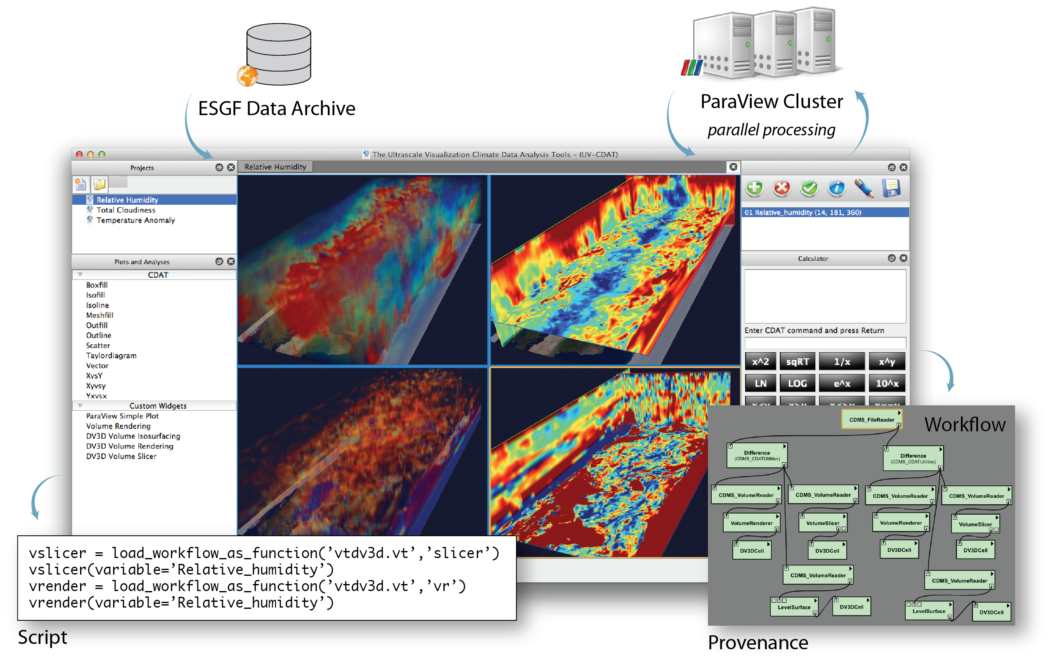
Ultra-scale Climate Data Analysis Tools (UV-CDAT)
Approach
Integrates several existing, widely used open-source data analysis and visualization packages into seamless environment
CDAT – Climate data analysis/viz
VTK - Visualization Toolkit
R – Statistical analysis
VisTrails – Workflow Provenance
VisIt, ParaView, DV3D – 3D Visualization
Local and remote visualization and data access
Comparative visualization and statistical analyses
Robust tools for regridding, reprojection, and aggregation
Support for unstructured grids and non-gridded observational data, including geospatial formats often used for observational data sets
Workflow analysis and provenance management
Joint climate data vision for large-scale visualization and analysis.
Highlights
Official Release of UV-CDAT version 1.0.0
Website documentation and Video Tutorials
Ultra-scale Reusable Analysis and Diagnostics Framework (U-ReAD)
Ensemble Data analysis Environment (EDEN)
LibCF Mosaic Grids and ESMF Regridding
Climate Science R&D

Slide 3
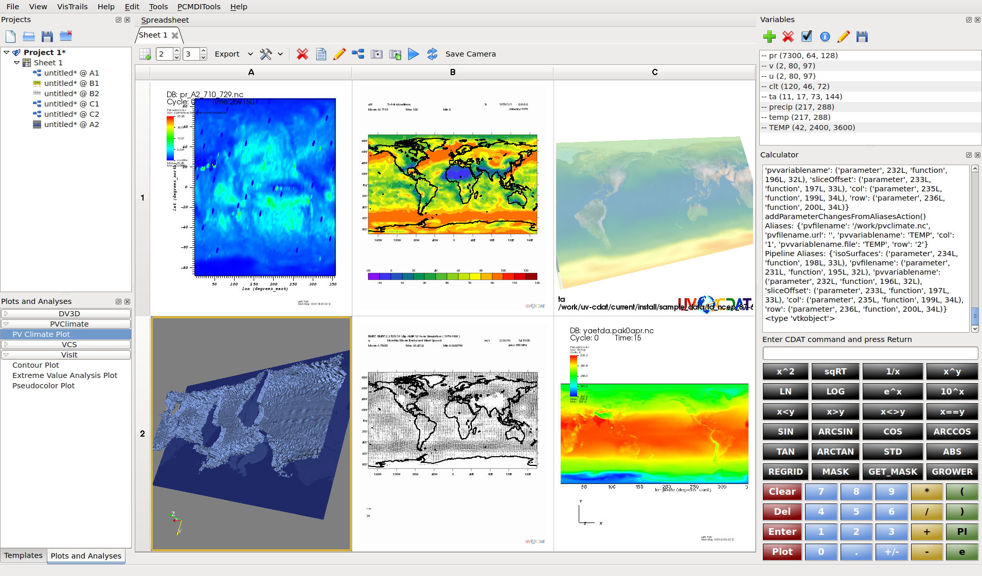
UV-CDAT Displaying CDAT, DV3D, ParaView, VisIt, and R

Slide 4
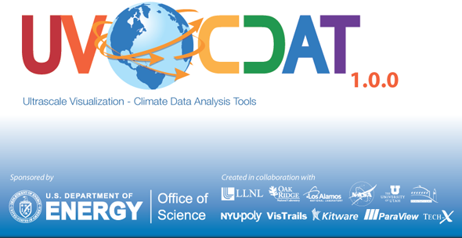
Official Release 1.0.0
UV-CDAT = CDAT · VisTrails · ParaView · VisIt · DV3D · R
1.0.0 Official Release – May 9th, 2012
1.0.0 Beta Release – April 4th, 2012
1.0.0 Alpha Release – February 20th, 2012
Downloads – 170+ Downloads since beta version in less than 3 weeks
Usage – 600+ different users from 400+ machines logged using UV-CDAT since alpha release
Release and presentations can be found at the following URLs: http://uvcdat.llnl.gov/
User support mailing list: uvcdat-support@llnl.gov

Slide 5
Promoting the Use of UV-CDAT
(http://uvcdat.llnl.gov)
Conferences and Workshops
AGU Sessions:
Visualization
Course on Advances in Ultra-scale Data Analysis and Visualization using Python
Frontiers in Computational Physics Modeling the Earth System
Big Data and Long Tails: Addressing the Cyber-Infrastructure Challenges for Research on a Budget
Papers
IPAW ’12: Designing a Provenance-Based Climate Data Analysis Application (demo paper)
CMIP5 papers used UV-CDAT to generate data and visualization
Posters
CMIP5 workshop posters prepared using UV-CDAT
Point of Contacts at Each Site
User & Technical
Live Online Tutorials and Presentations
Tech-X: New Distributed Array Functionality in UVCDAT

Slide 6
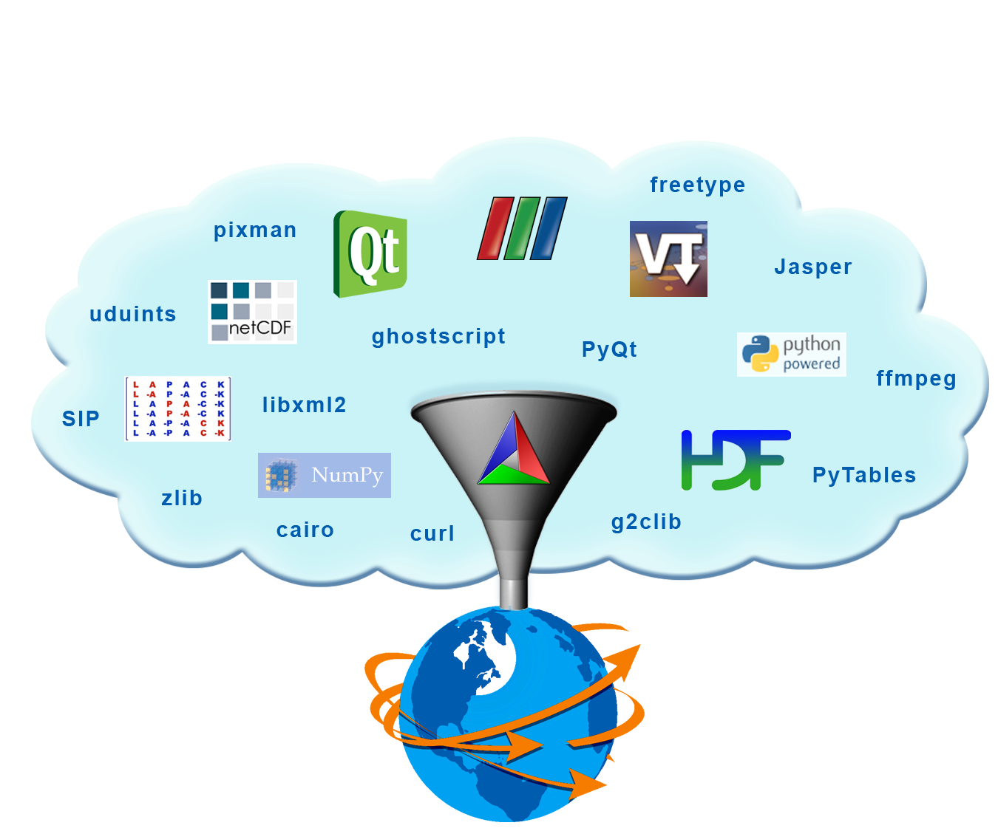
Official Release 1.0.0 Build and Installation
Kitware/LLNL finished transitioning the build from configure to CMake
ParaView enabled as a client, took out server build of ParaView from “general” distribution
Qt is now a pre-requirement to UV-CDAT, binary distribution are widely available, optimized and hassle-free
Build knowledge has been transferred to others in the group (PCMDI/Tech-X/LBNL) so that support can be faster
UV-CDAT can now be built with the VisIt open source scientific visualization package (Visual Data Exploration Analysis of Ultra-Large Climate Data team collaboration)
UV-CDAT Installation
– Binaries (Ubuntu, Fedora, Mac) – Manual (Linux, Mac) – URL (http://uvcdat.llnl.gov/install)

Slide 7
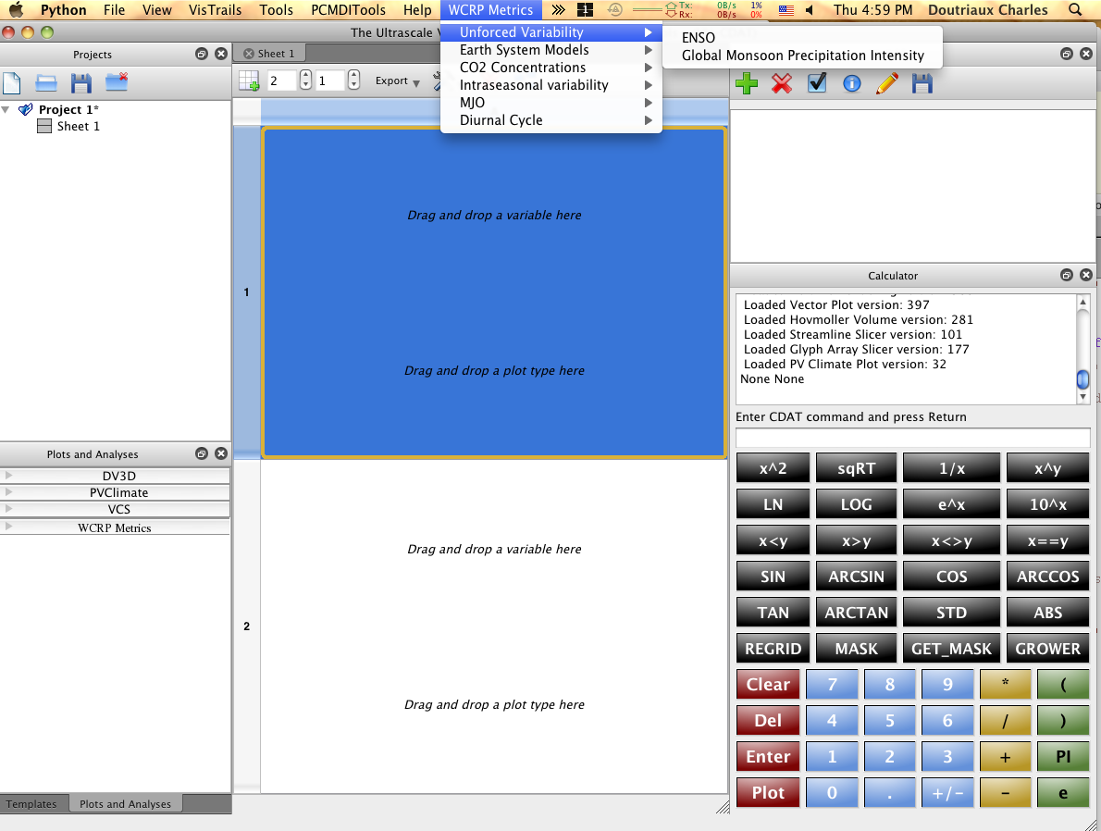
U-ReAD: UV-CDAT’s Impact on CMIP5
Ultra-scale Reusable Analysis and Diagnostics Framework (U-ReAD)
Offers basis for rapid an seamless development of scientific applications.
Automatically integrated with UV-CDAT (menus/graphics/provenance), for FREE via doc string mechanism
Benefits for developers who join the program:
Broad users community
Broad Exposure
Free base classes
Free support for embedding
their work into UV-CDAT
Free repo
WGNE/WGCM Metrics panel endorsed
U-ReAD as their software development
platform: U-ReAD developing CMIP5-
specific I/O routines/classes that
will fit into UV-CDAT.
U-ReAD will also
develop CMIP5 related derived
products such as (but not limited to):
Microwave Sounding Units (MSU)
equivalent temperatures
Zonal Means
3D ocean derived quantities
Madden Julian Oscillation (MJO)
Custom Menu
Custom Graphics
7
Notes:
two use-cases in place: local
(user downloads the whole thing and
runs it on his machine) and distributed
(user downloads software only and runs it on remote data).

Slide 8
Ensemble Data analysis ENvironment (EDEN)
Progress
Platform independent exploratory analysis tool for CLM4 researchers to explore ensembles and global model simulations
Successful collaboration with CSSEF team to develop and evaluate effectiveness of EDEN with actual simulation data (resulting manuscript to be presented at ICCS 2012)
Invited talk on EDEN given at NCAR Land Model Working Group meeting in March 2012
Analysis on ORNL’s EVEREST facility
Next Steps Forward
Parallelization of statistical and I/O operations to scale to full spectrum CLM4 analysis
Focus on interactive, full scale analysis of CLM4 global simulation datasets
Incorporate new analytics and visualization techniques in collaboration with CSSEF researchers
Make EDEN available as an open source tool for use by CLM4 researchers
Incremental integration of EDEN functionality into UV-CDAT PyQt environment

Slide 9
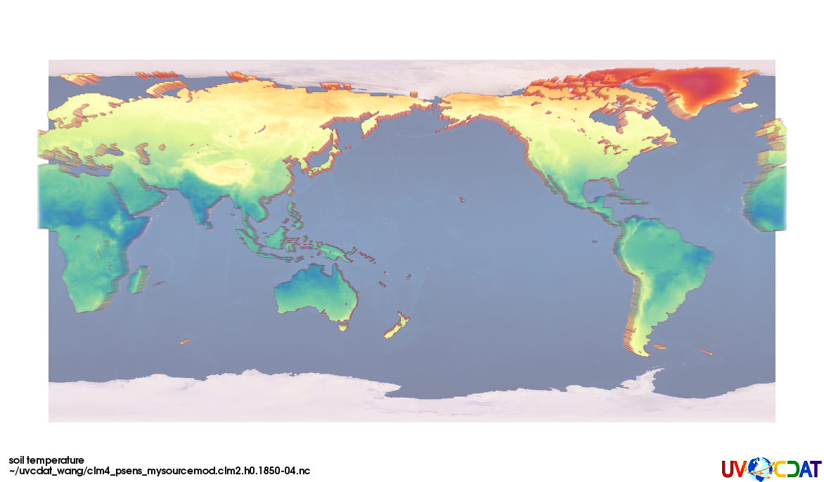
ORNL Climate Scientists
CLM4 Scientists want to use UV-CDAT to produce diagnostic images after each run
Want to produce a series of standard plots from CLM ensembles and uncertainty quantification methods
Requirements and Next Steps
Need to improve UV-CDAT’s automation capabilities
Improve ability to operate on multiple files (computing means across multiple time steps, for example)
Need to install UV-CDAT on one or more NCCS servers – input files are too big to download to scientists’ desktops

Slide 10
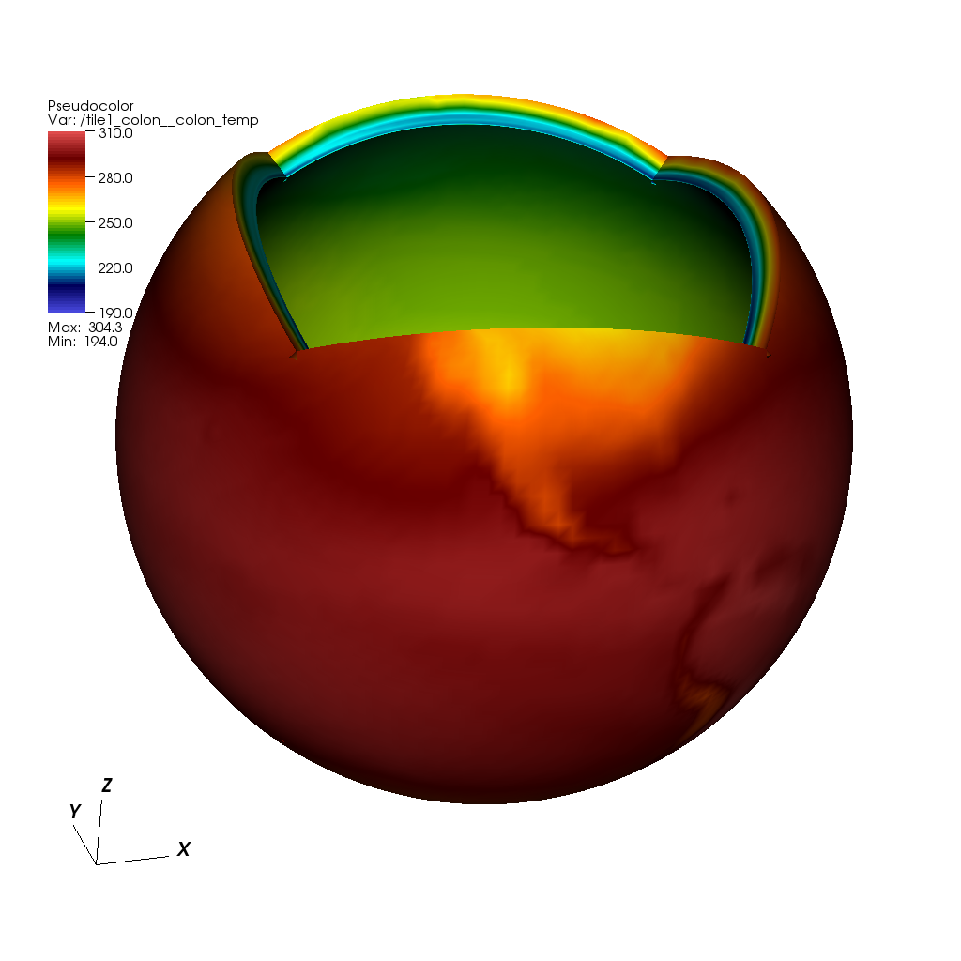
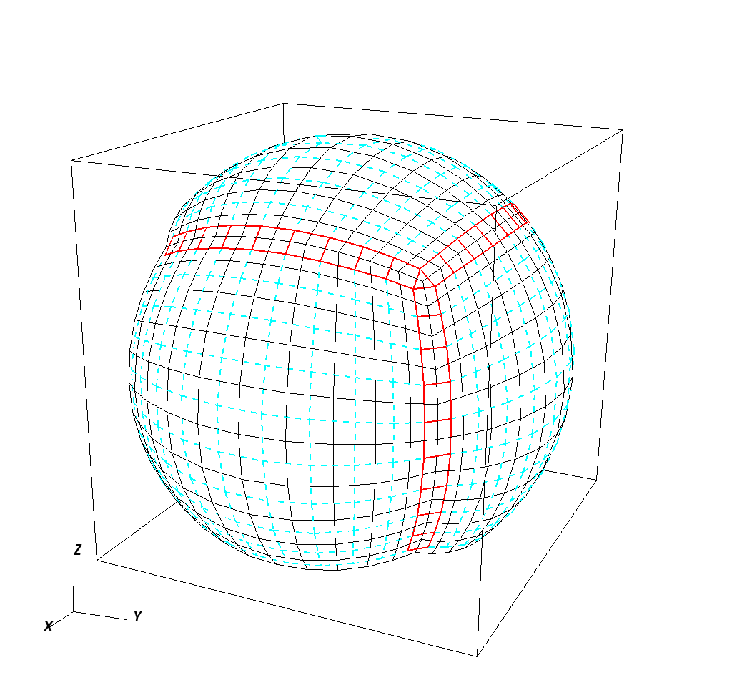
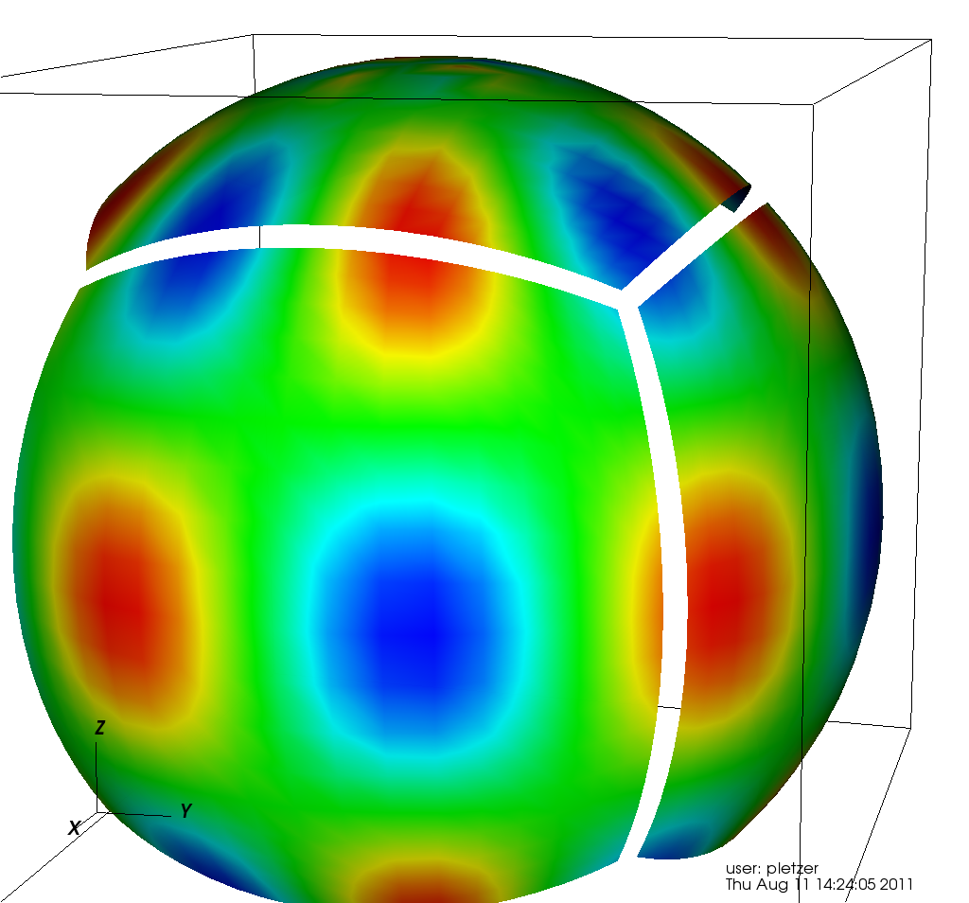
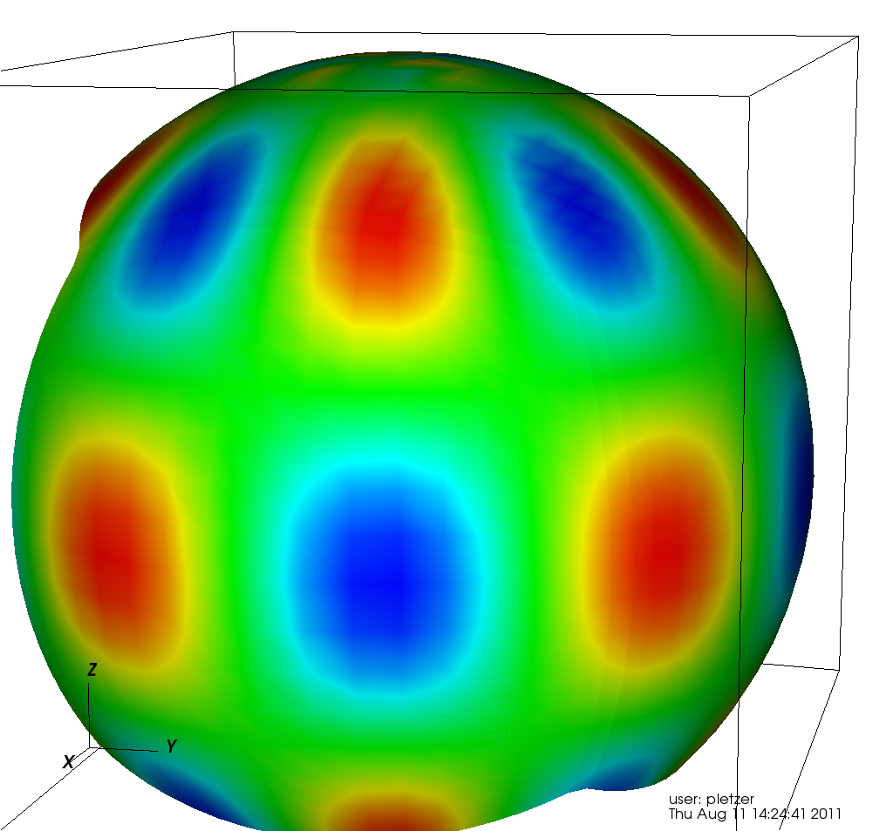
UV-CDAT Supports Mosaic Grids
Cubed sphere mosaic requires connectivity between tiles to fill in gaps in cell centered data visualization
Complies with emerging Gridspec CF standard
Atmospheric temperature from GFDL model
Create seam grids
Fill gaps

Slide 11
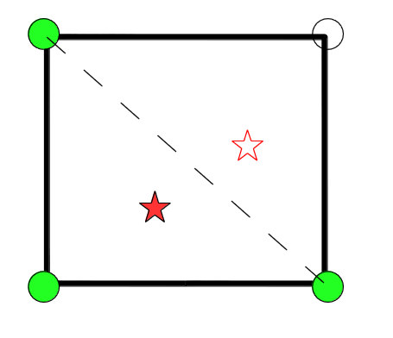
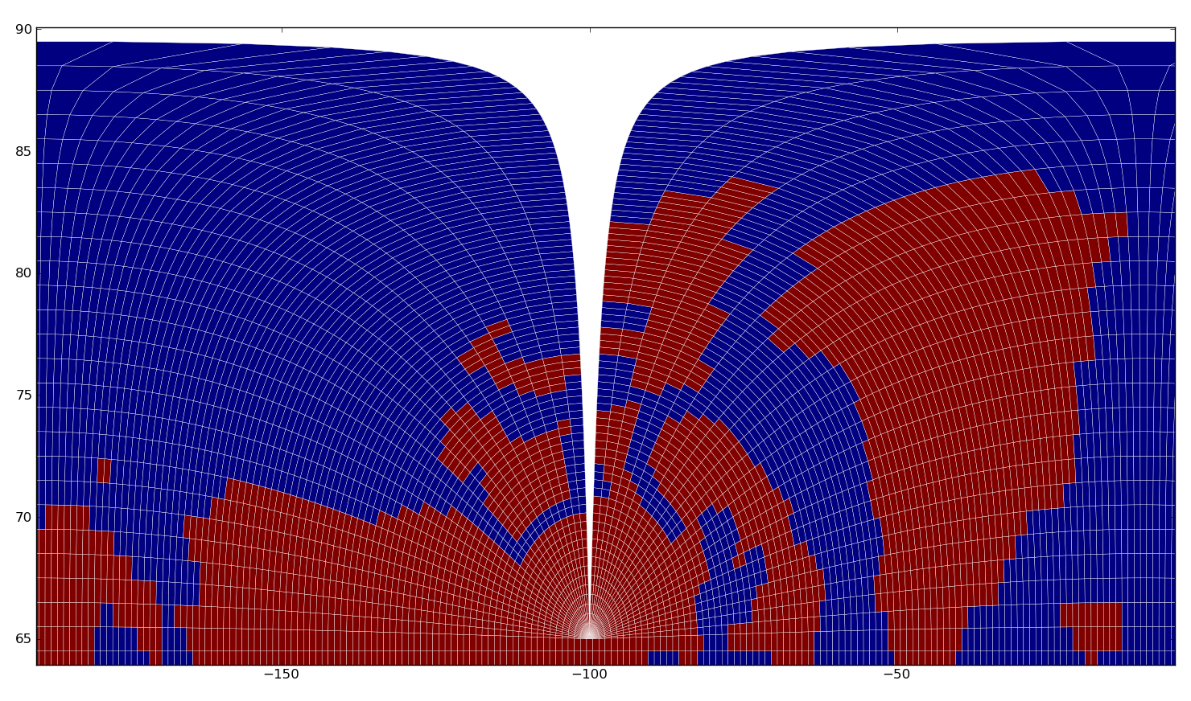
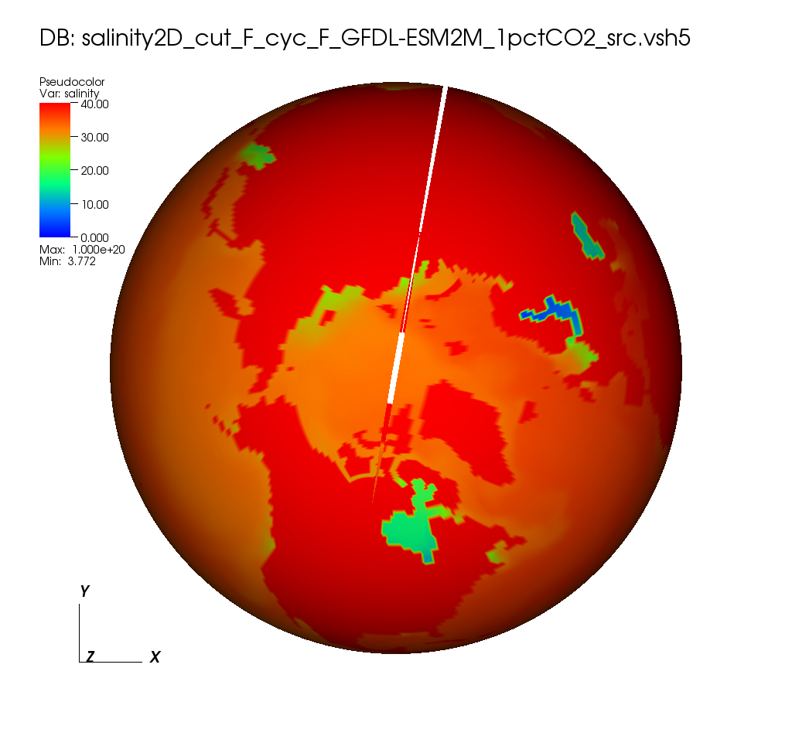
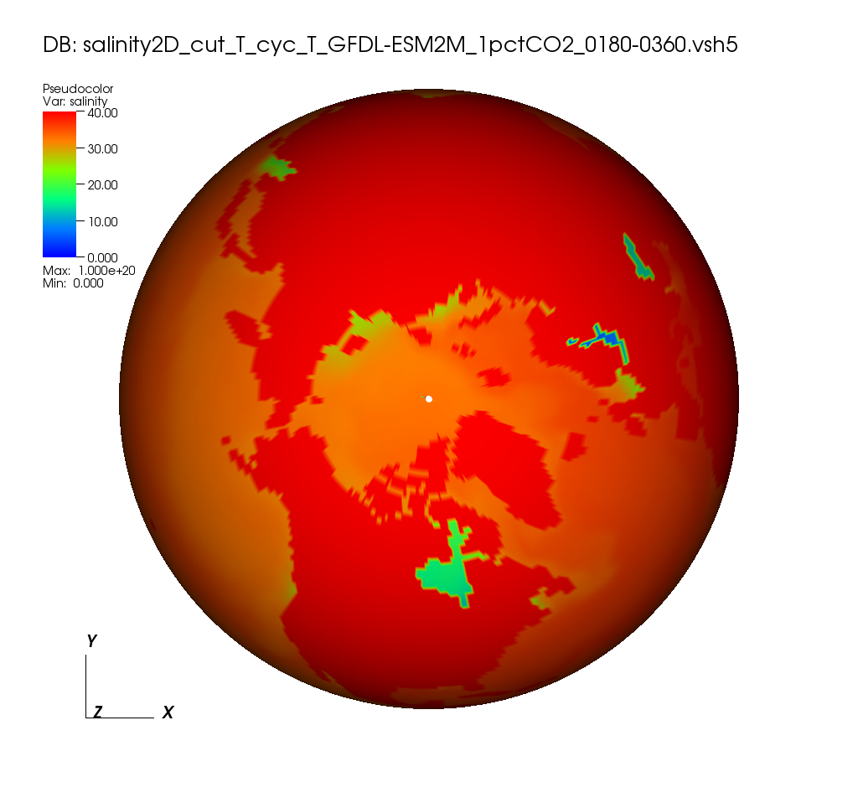
LibCF Interpolation added to UV-CDAT
Valid cell region
N-Dimensional linear interpolation
Curvilinear grids, partial cell masking
Handles periodicity and cuts in grids
Fast C Implementation
Exercised on PCMDI ocean and atmospheric data
Default regridder in UV-CDAT
Tripolar grid
Cut and periodicity not handled
Cut and periodicity handled

Slide 12
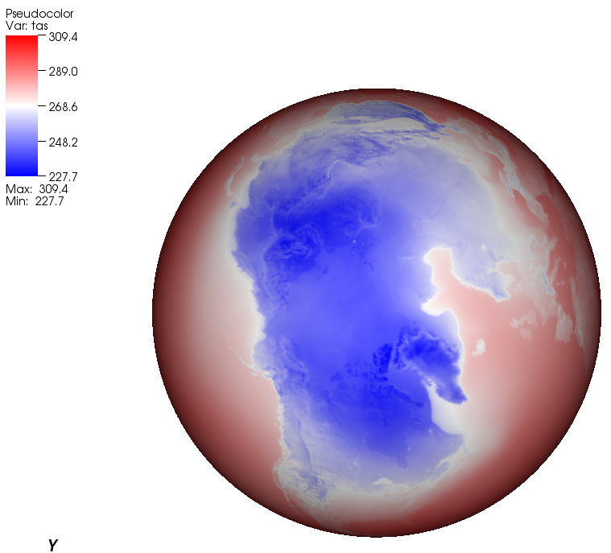
Conservative Interpolation with ESMF
Python interface ESMP to Earth System Modeling Framework (ESMF)
Can interpolate in Cartesian coordinates to avoid grid singularities
# space dims ≥ # topological dims
Conservative interpolation is available
(mass, energy)
Work in progress (collaboration with NOAA)
Conservatively interpolated air surface temperature
GFDL HIRAM C360 720x1440

Slide 13
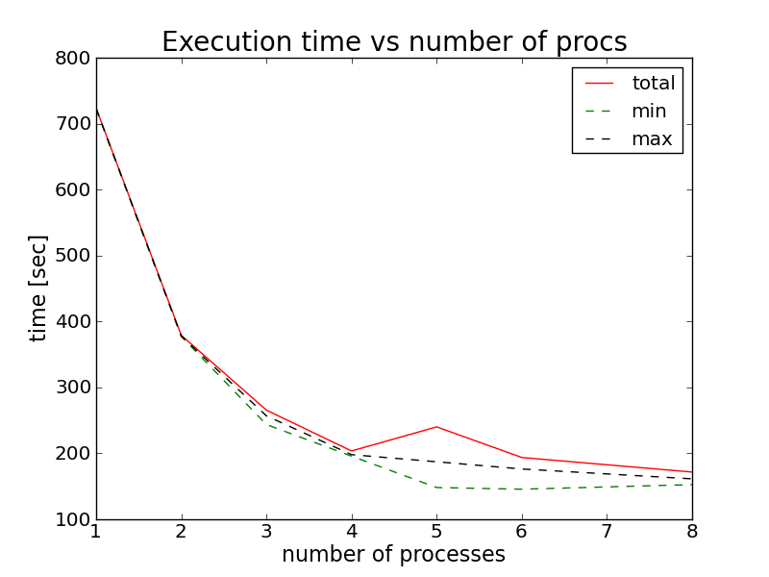
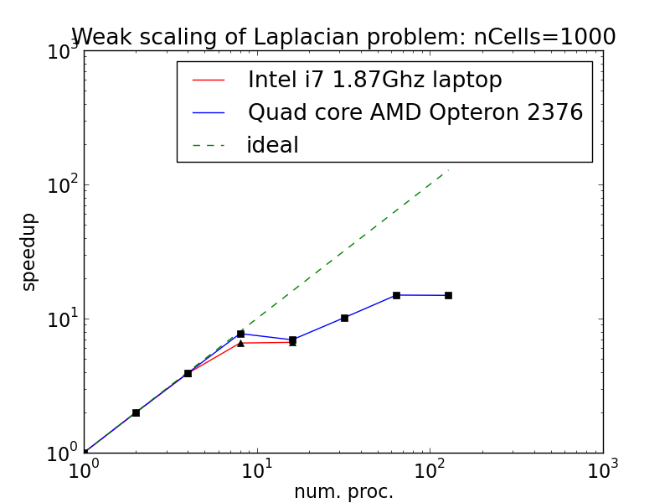
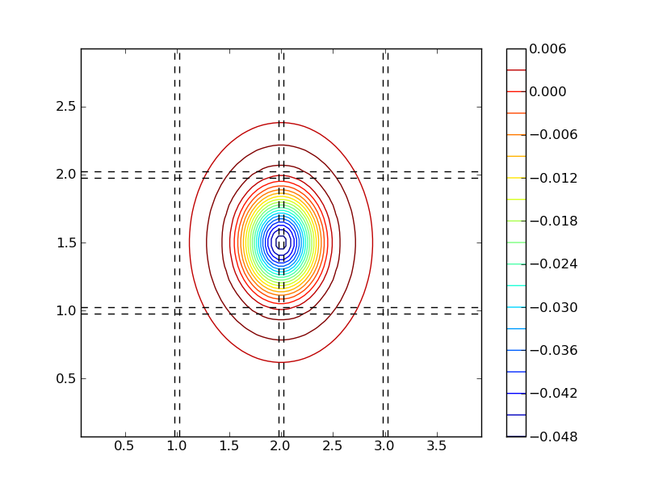
Parallel Processing in UV-CDAT
MPI aware, UV-CDAT will build mpi4py if MPI libraries are found on system
Linear interpolation can be run in parallel
Parallel conservative interpolation (ESMF) is work in progress
Built-in support for distributed arrays in cdms2 variables. Any processor can access the halo data residing on other processors using MPI one-sided communication
Parallel Scaling for LibCF Interpolation of 3D Ocean data
Data local to a processor
Halo width
Up to 100 million cells
Halo data
Data not accessible to other procs.

Slide 14
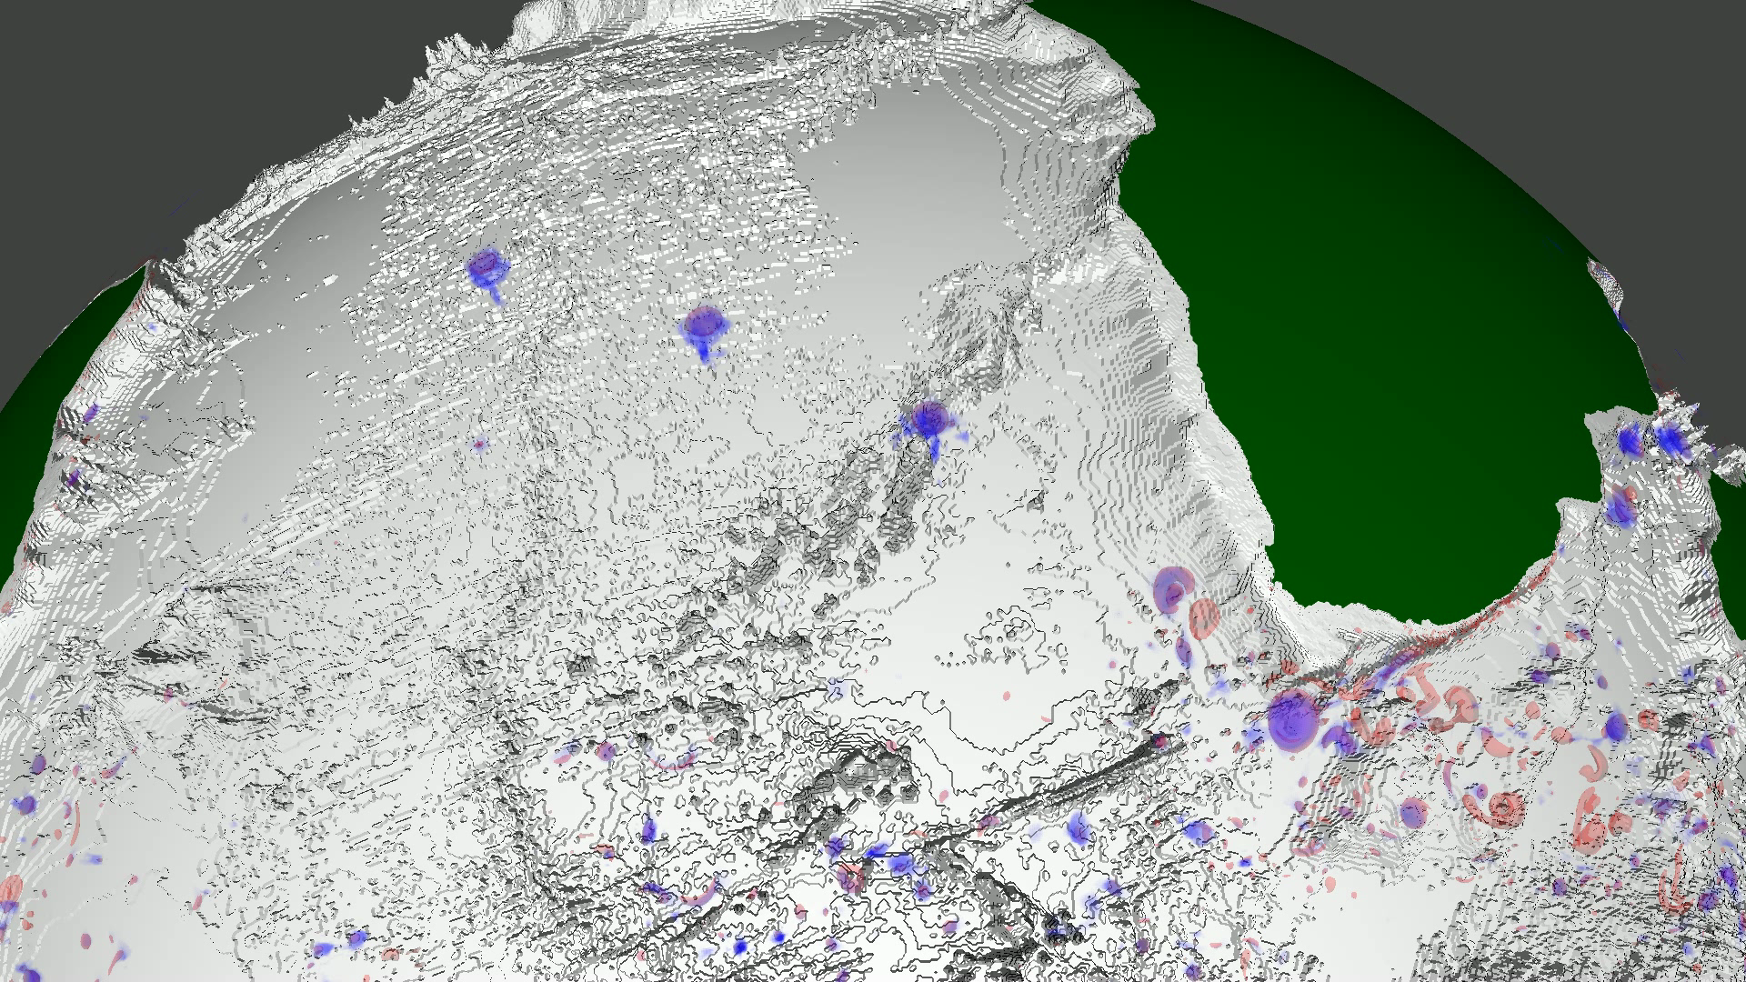
Climate Research
Ocean Eddys as transport containers?
Visualizing Ink stained Eddys
Williams, S., Hecht, M., Petersen, M., Strelitz, R., Maltrud, M., Ahrens, J., Hlawitschka, M. and Hamann, B. (2011), “Visualization and Analysis of Eddies in a Global Ocean Simulation,” Computer Graphics Forum, 30: 991–1000. doi: 10.1111/j.1467-8659.2011.01948.x
Williams, S.; Petersen, M.; Bremer, P.-T.; Hecht, M.; Pascucci, V.; Ahrens, J.; Hlawitschka, M.; Hamann, B.; , "Adaptive Extraction and Quantification of Geophysical Vortices," Visualization and Computer Graphics, IEEE Transactions on , vol.17, no.12, pp.2088-2095, Dec. 2011 doi: 10.1109/TVCG.2011.162 URL: http://ieeexplore.ieee.org/stamp/stamp.jsp?tp=&arnumber=6064973&isnumber=6064926
S. Williams, M. Petersen, M. Hecht, M. Maltrud, J. Patchett, J. Ahrens, and B. Hamann, “Interface Exchange as an Indicator for Eddy Heat Transport,” accepted to EuroVis 2012

Slide 15

Parallel I/O Readers within UV-CDAT
CAM Reader
supports VOI in reader
supports time properly and works in parallel
Tech Being used by Community
http://www.kitware.com/news/home/browse/389?siteid=10
Unstructured POP Reader
Interpolates scalar and vector data on proper grid
Horizontal velocity components are properly aligned and scaled in ParaView's Cartesian coordinate system
Compute vertical velocity component in serial and are working on doing that in parallel
This is needed to compute MOC

Slide 16
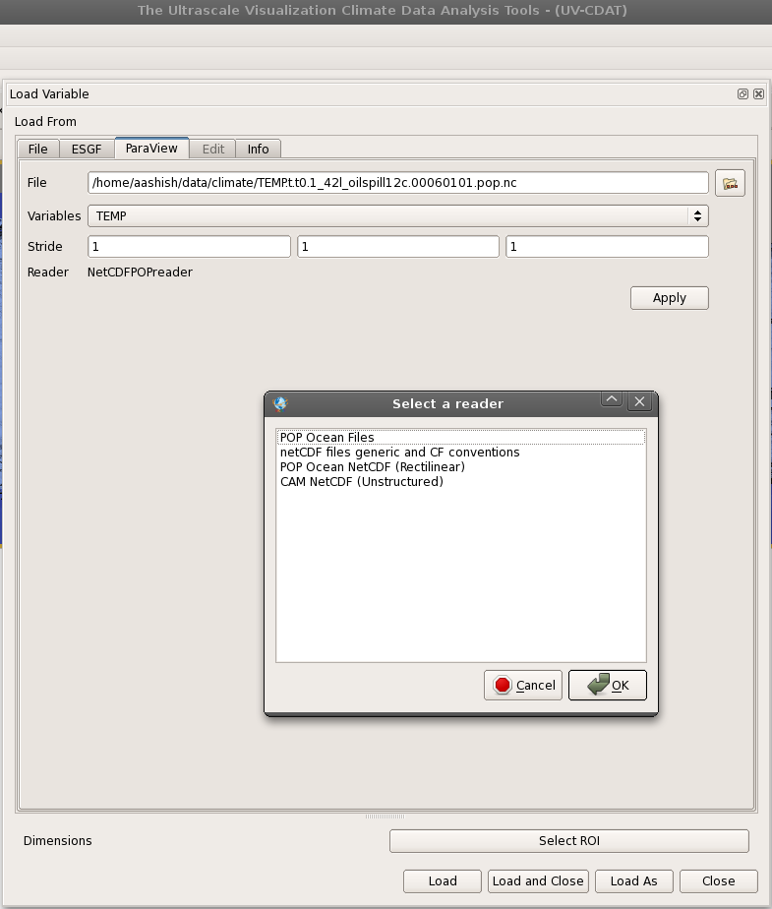
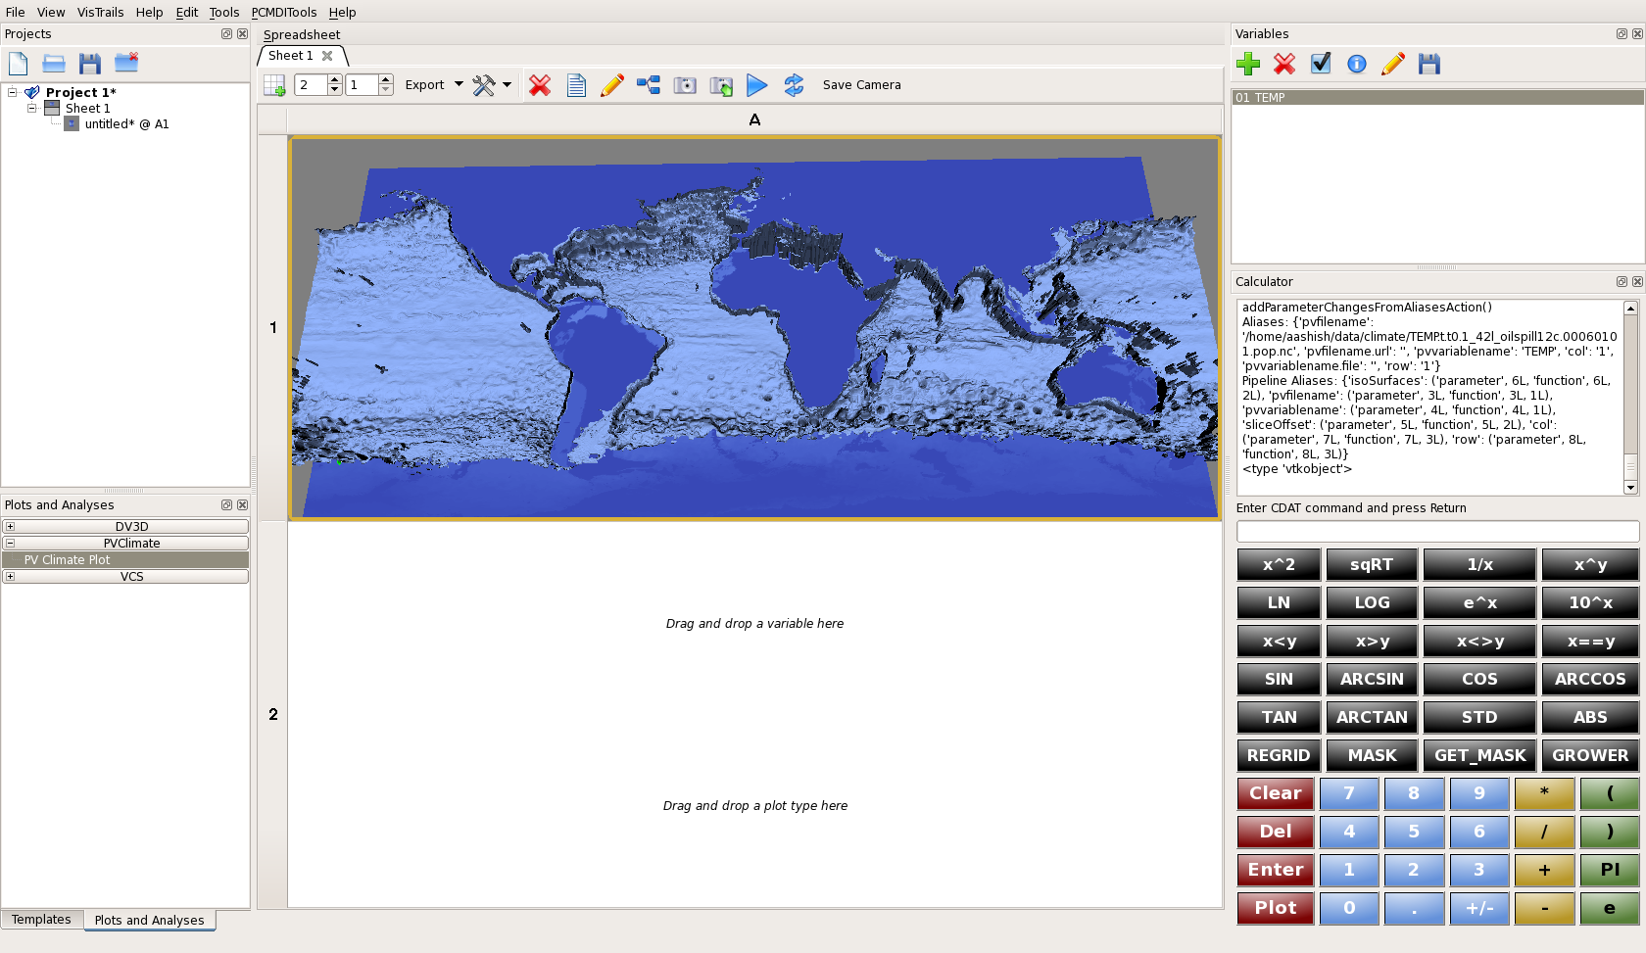
Production Delivery
ParaView integration with UV-CDAT framework that includes support for ParaView' s client / server mode within UV-CDAT
Availability of Parallel Unstructured POP Reader in UV-CDAT ParaView
Various build system improvements

Slide 17
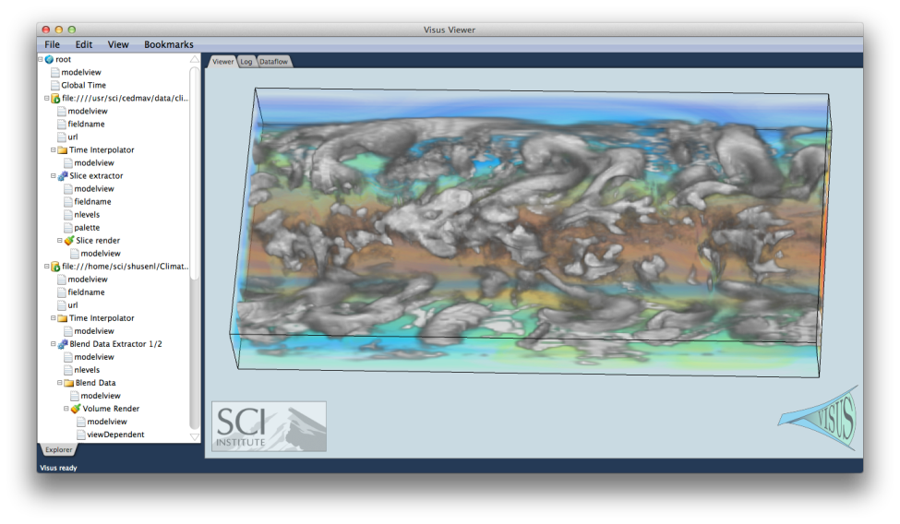
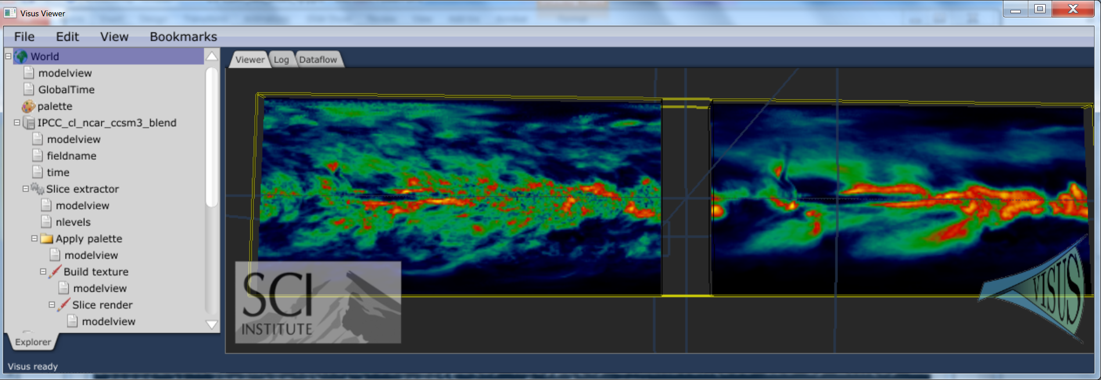
Remote climate Data Analysis and Visualization
ViSUS data streams allow to merging multiple datasets in real time
Time interpolation of and concurrent visualization of climate data ensembles defined on different time scales
Current development of Qt interface for full integration into UV-CDAT
Server side and client side computation of statistical functions such as median, average, standard deviation, …….
Standard Deviation and Average of ten climate models

Slide 18
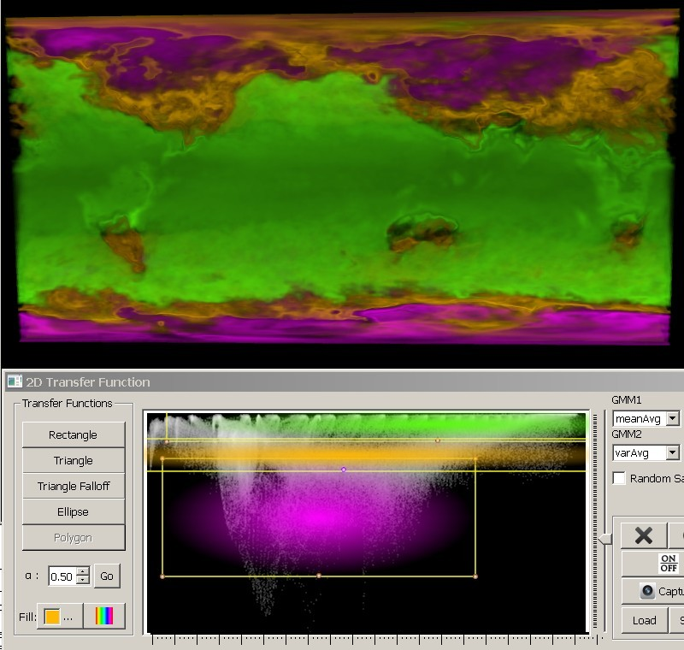
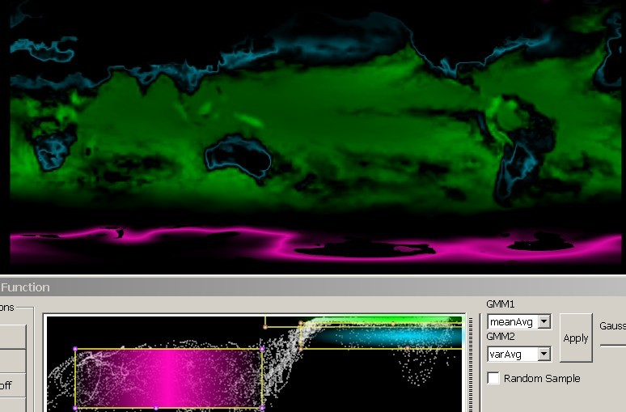
Uncertainty Visualization for Climate Simulations
Interactive visualization of climate data ensembles
Use of multidimensional transfer functions to select emerging structures of interest
Collaboration with the SDAV Scidac 3 institute for adoption of UQ visualization techniques
Collaboration with Sandia MAPD team for statistical analysis of climate data

Slide 19
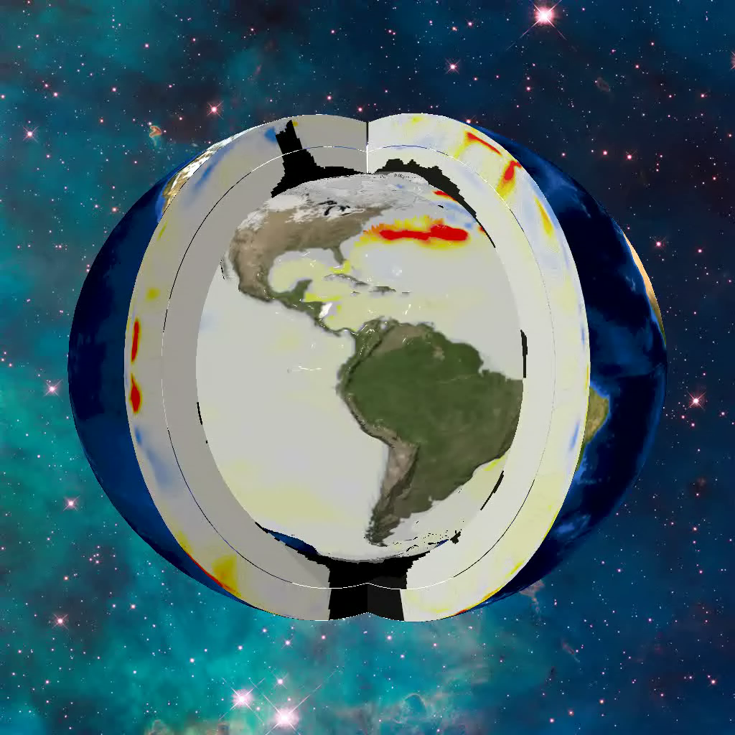
Human-Induced Global Ocean Warming on
Multi-Decadal Time Scales
Notes:
Nature Climate Change Journal

Slide 20
BER Projects and Missions
CSSEF
CMIP5
Also important for other BER and new SciDAC projects:
UV-CDAT used for model validation in several existing BER projects, including CMIP5, CSSEF, COSIM
Multi-scale project will require new unstructured variable-resolution grid capabilities
UQ is an important component of several projects and requires comparative analysis of many ensemble members and tools like EDEN
Many BER/SciDAC projects require large scale simulations performed at LCFs and UV-CDAT provides capability for shared analysis of common simulations

Slide 21
Near-Term Plans and Directions
Reduce executable size and stress test for system performance on LCFs and other platforms
Review and refine graphical user interface and workflow
Allow fast implementation and integration of external software via “Plug-in Wrappers”
Refine the integration of UV-CDAT as a backend service to ESGF and interact directly with ESGF to allow full client-side usage
Continue packaging and user documentation
Present live on-line courses on UV-CDAT and generate as video tutorials hosted on YouTube.
Provide ultra-scale analysis and visualization services to BER climate research teams
Software Quality Assurance

Slide 22

Demonstration and Video Tutorials
Recap
Collaborations
Complexity
Level of software builds and integration
Functionalities
Component modularity and organization
Interaction
Live UV-CDAT Demonstration …
YouTube Video Tutorials …
Q & A

